Slide 1
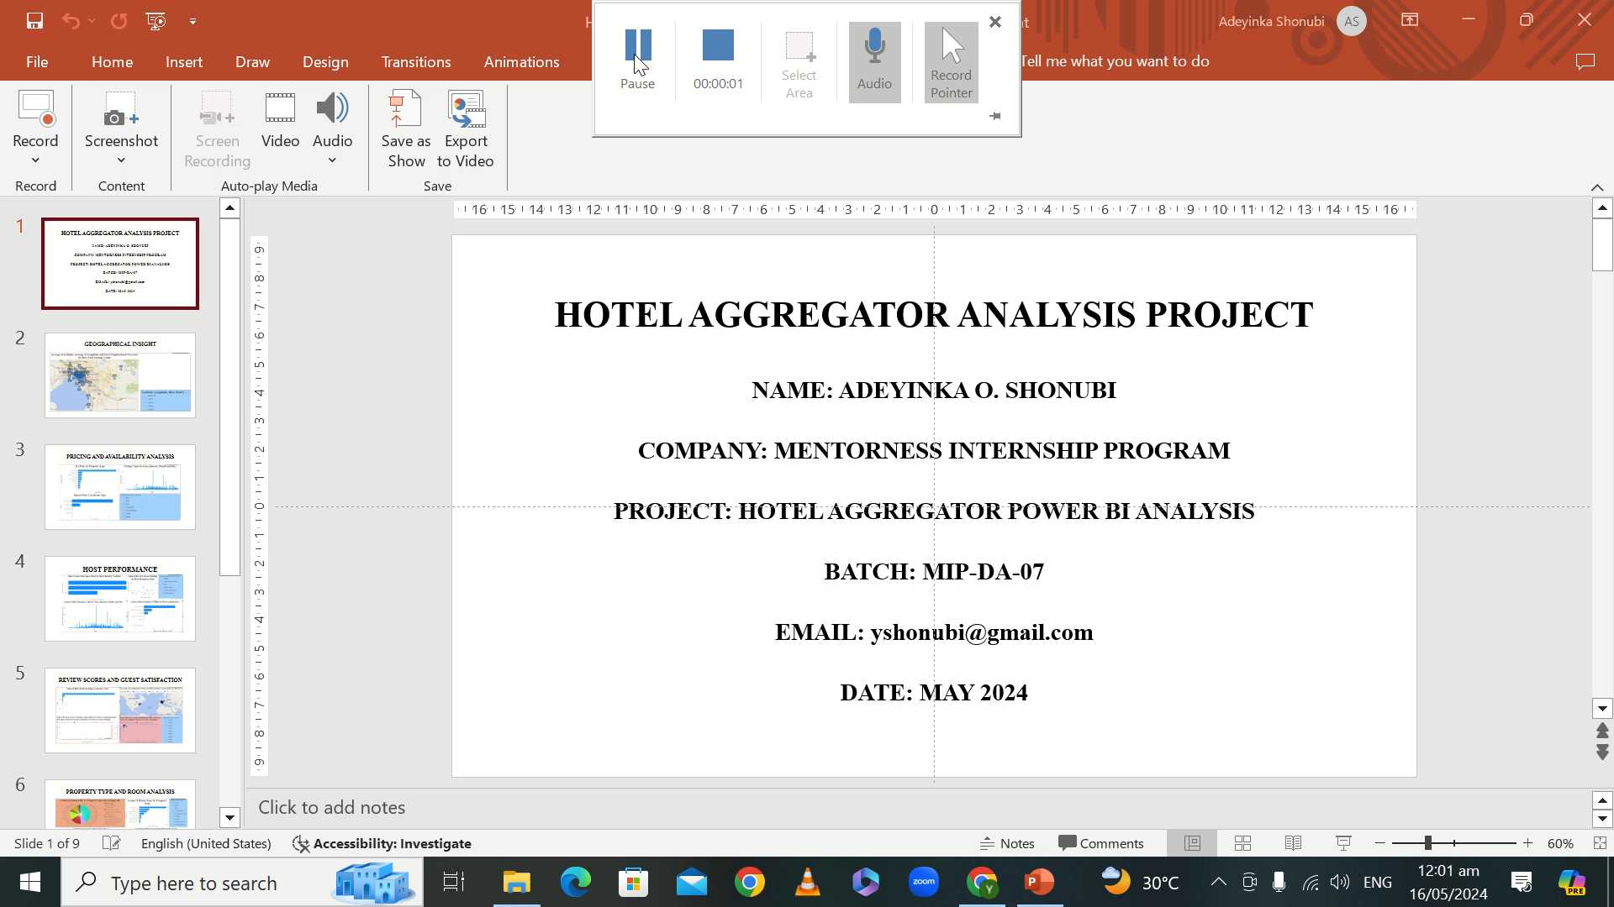
HOTEL AGGREGATOR ANALYSIS PROJECT
NAME: ADEYINKA O. SHONUBI
COMPANY: MENTORNESS INTERNSHIP PROGRAM
PROJECT: HOTEL AGGREGATOR POWER BI ANALYSIS
BATCH: MIP-DA-07
EMAIL: yshonubi@gmail.com
DATE: MAY 2024

Slide 2
CONTENT
Geographical Insight
Pricing And Availability Analysis
Host Performance
Review Scores And Guest Satisfaction
Property Type And Room Analysis
Report

Slide 3
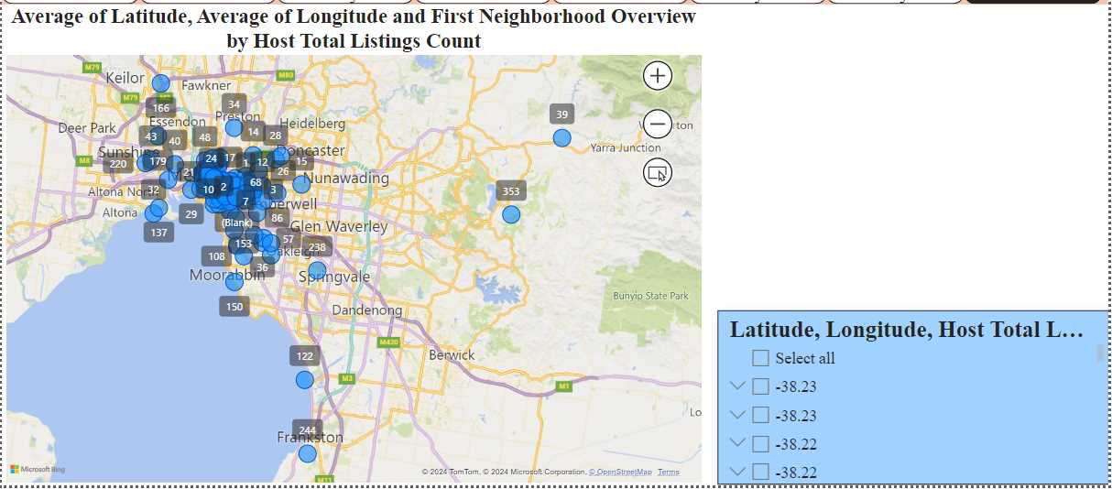
GEOGRAPHICAL INSIGHT

Slide 4
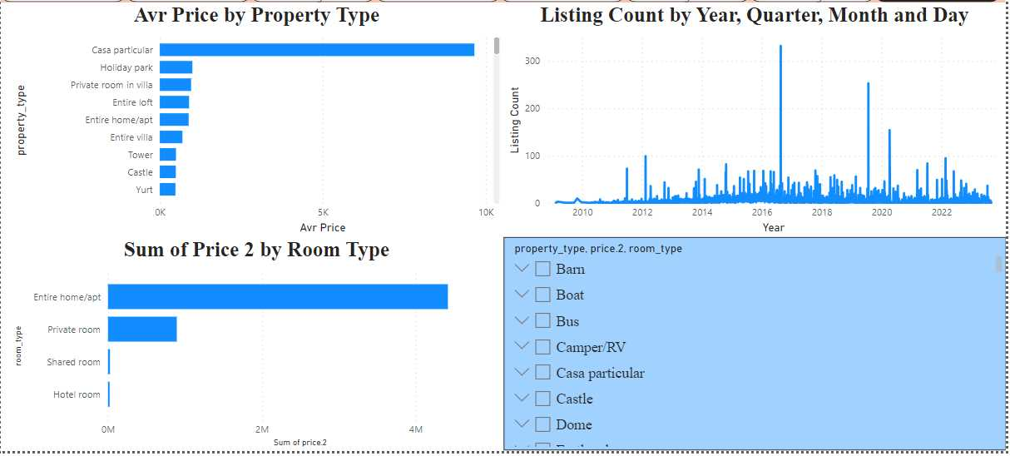
PRICING AND AVAILABILITY ANALYSIS

Slide 5
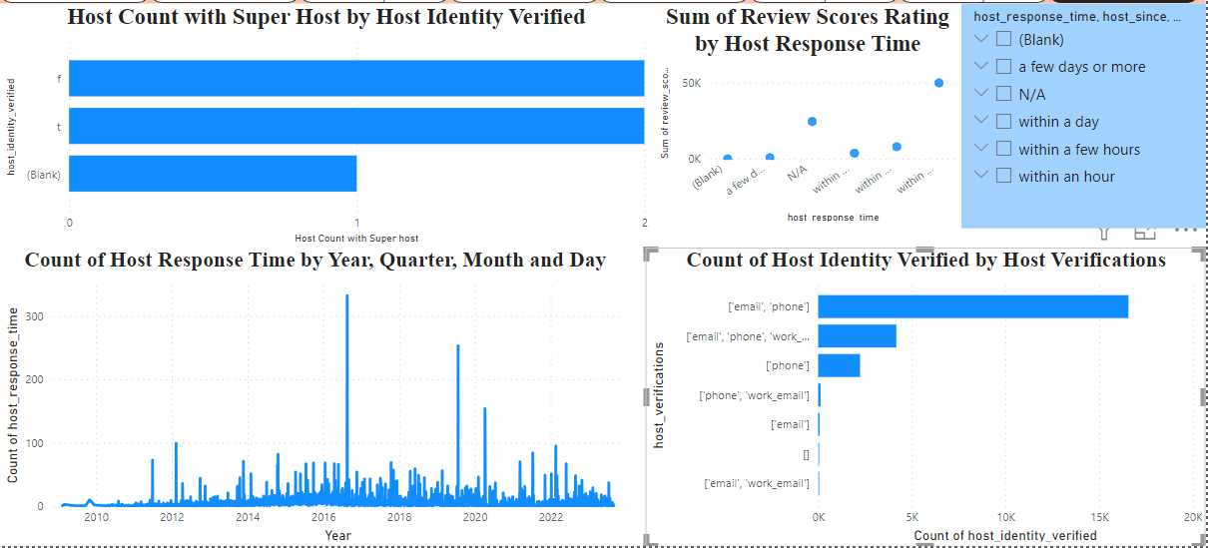
HOST PERFORMANCE

Slide 6
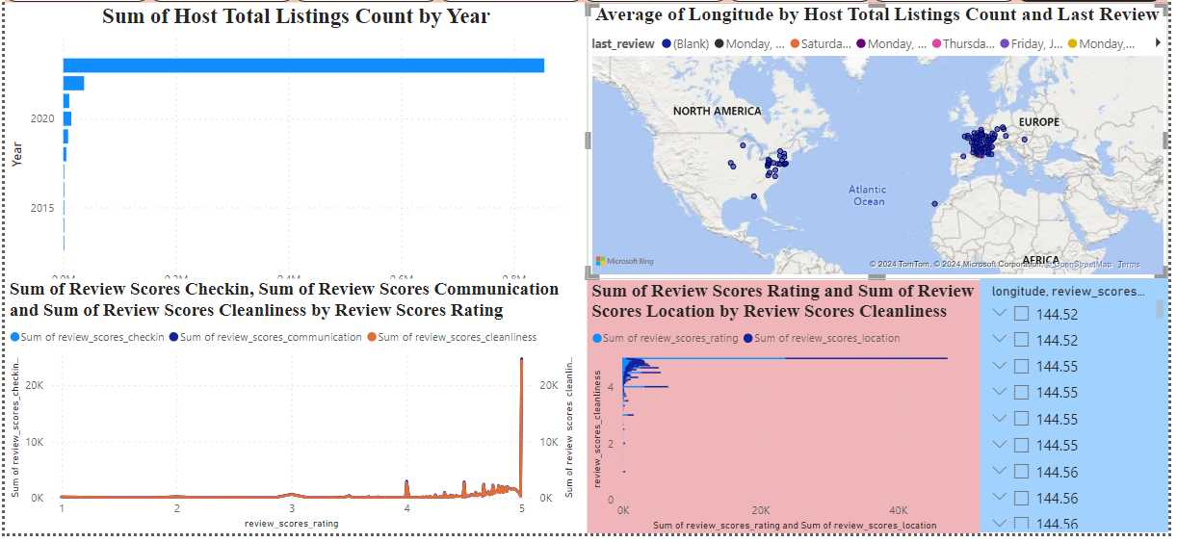
REVIEW SCORES AND GUEST SATISFACTION

Slide 7
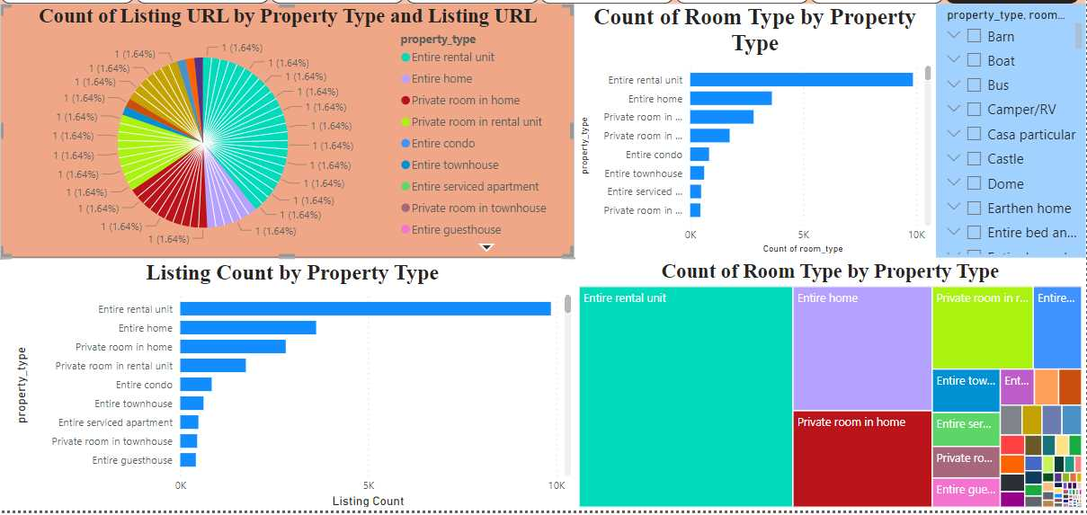
PROPERTY TYPE AND ROOM ANALYSIS

Slide 8
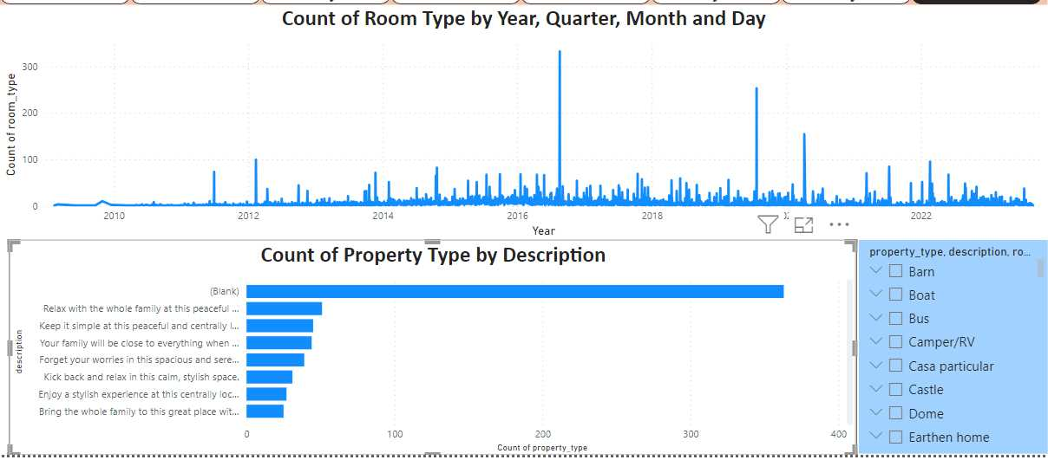
PROPERTY TYPE AND ROOM ANALYSIS

Slide 9
REPORT
Geographical Insight
Insight
This shows the neighborhoods with the high concentration of listings and their host location.
Recommendation
The host can also be established in neighborhoods with less concentration so that there would be less congestion, especially at peak periods.
Pricing and Availability Analysis
Insight
In 2016, a room type (entire home/apartment had the highest rental)
Recommendation
Measures should be put in place to increase sales because, after 2016, the following years have not raised as high income as 2016.
Host Performance
Insight
This shows host performance and attributes over the years.
Recommendation
Although the performance was good, it could be better to increase the flow of income.

Slide 10
REPORT
Review Scores and Guest Satisfaction
Insight
This shows the review scores and guest satisfaction around the world.
Recommendation
North America would need to improve in this area so that they can increase sales and satisfy the customers.
Property Type and Room Analysis
Insight
This shows that the entire rental unit room type was the most sought after compared to the private unit which has the least booking, though this may be as a result of the price of the room.
Recommendation
The host should provide ways to attract customers to the private rooms or make them more price-friendly for income earners to rent.

Slide 11
THANK YOU

